Slide 1

Bootcamp project
Student Activation Analysis

Slide 2
What is Activation?

Slide 3
Exploratory Data Analysis

Slide 4
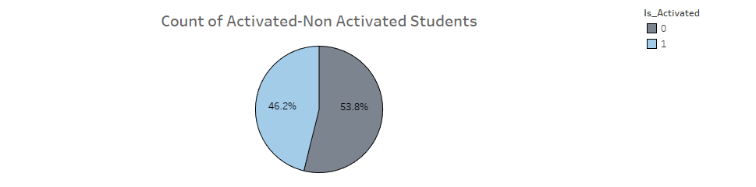
How many students are activated in this dataset
There are approximately 4.6k activated students while the rest are not almost 5.4k students

Slide 5
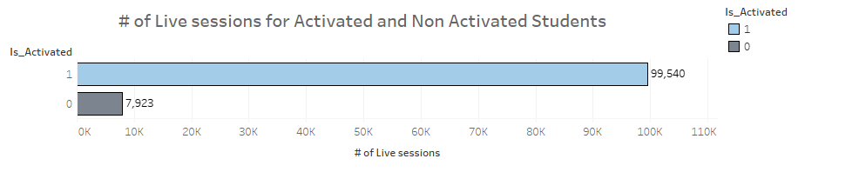
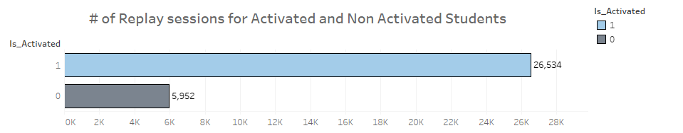
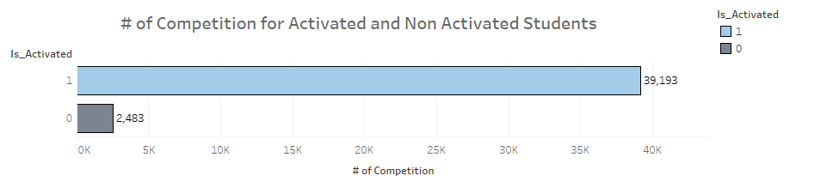
What was the behavior of the students?
Although most of these students are not activated, we see that the activated students explore the platform more.

Slide 6
Prediction Models

Slide 7
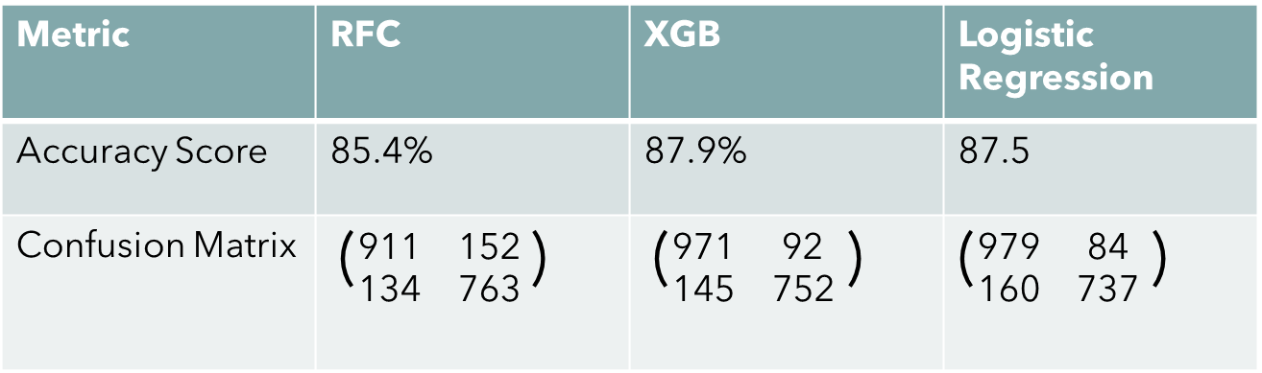
RFC vs XGB vs Logistic Regression
Metric | RFC | XGB | Logistic Regression
Accuracy Score | 85.4% | 87.9% | 87.5
Confusion Matrix | ($\begin{matrix}\text{911} & \text{152} \\ \text{134} & \text{763}\end{matrix}$ ) | ($\begin{matrix}\text{971} & \text{92} \\ \text{145} & \text{752}\end{matrix}$ ) | ($\begin{matrix}\text{979} & \text{84} \\ \text{160} & \text{737}\end{matrix}$ )

Slide 8
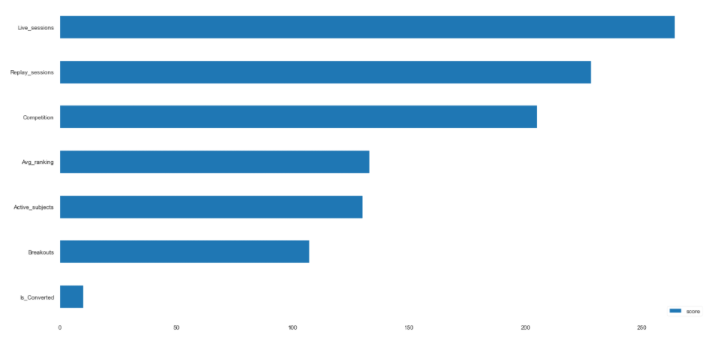
What Feature Has The Most Impact On The Model?
From the graph shown we can say the more student attend multiple live sessions the more activated students we get.

Slide 9
The End

